Slide 1
Nida and “the science of translating”
第一小组：黄润宏20261210045 黄业旋20261210030
Notes:
Opening slide for the complete Nida presentation. The deck follows five questions: why translation can be seen as art or science; who Nida was; what social and communication problems Bible translation faced around 1960; how formal and dynamic equivalence differ; and how Nida analysed sentences and vocabulary.

Slide 2
Science or Art?
Notes:
Opening slide for the complete Nida presentation. The deck follows five questions: why translation can be seen as art or science; who Nida was; what social and communication problems Bible translation faced around 1960; how formal and dynamic equivalence differ; and how Nida analysed sentences and vocabulary.

Slide 3
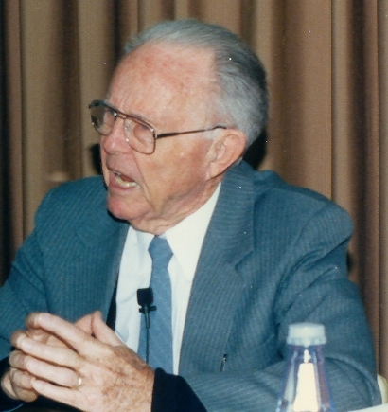
NIDA · 02 / 05
1914 生于美国俄克拉何马城。
1936 获 UCLA 学士；1943 年获密歇根大学语言学博士。
1943 加入 American Bible Society（ABS），长期负责翻译事务。
1949 创办并编辑 The Bible Translator。
1964 《Toward a Science of Translating》出版。
1969 与 Charles R. Taber 合著《The Theory and Practice of Translation》。
1980s 初期退休，之后仍持续讲学与写作
Eugene A. Nida
1914-2011
Notes:
Eugene Albert Nida (11 November 1914 - 25 August 2011) was an American linguist, Bible translator and one of the founders of modern translation studies. He joined the American Bible Society in 1943 and later served as Executive Secretary for Translations. Major publications include Message and Mission (1960), Toward a Science of Translating (1964), and The Theory and Practice of Translation (1969, with Charles R. Taber). Photo: Iamwretched, CC BY-SA 3.0, via Wikimedia Commons.

Slide 4
NIDA · 02 / 05
对于翻译学的贡献
• 推动翻译研究从经验规范走向可分析的科学。
• 提出 formal / dynamic equivalence，后称 functional equivalence。
• 将读者反应与跨文化交际纳入翻译评价。
• 发展 componential analysis 与 kernel sentence 方法。
• 推动 United Bible Societies 的跨宗派协作与全球圣经翻译。
• 被视为现代翻译研究的奠基者之一。
Notes:
Eugene Albert Nida (11 November 1914 - 25 August 2011) was an American linguist, Bible translator and one of the founders of modern translation studies. He joined the American Bible Society in 1943 and later served as Executive Secretary for Translations. Major publications include Message and Mission (1960), Toward a Science of Translating (1964), and The Theory and Practice of Translation (1969, with Charles R. Taber). Photo: Iamwretched, CC BY-SA 3.0, via Wikimedia Commons.

Slide 5
WARM-UP | EUGENE A. NIDA
01 / 05
How would you translate “troublemaker”?
在功能对等中，翻译优先追求最自然、最接近的交际效果。

Slide 6
CONTEXT · 03 / 05
1960: Bible translation as a social problem
为什么需要圣经翻译？
• 战后教会增长与去殖民化：更多语言群体要求用自己的语言接触经文。
• 识字率、教育差异与口传文化：译文必须听得懂、说得出、记得住。
• 多宗派、多机构协作：ABS、UBS、教会与译者在术语和版本上需要协调。
• 翻译规模扩大：语言记录、译者训练和质量管理必须形成可复制流程。
Notes:
Treat this as a historical reconstruction of the social and communication context around 1960. Message and Mission (1960) framed missionary and Bible translation work as communication across cultural and social boundaries. The wider context includes post-war church growth, decolonisation, oral and multilingual communities, cooperation among Bible societies and the need to train translators at scale. Nida's recurring difficulties were language non-equivalence, cultural distance, institutional expectations, heterogeneous audiences and a lack of systematic methods.

Slide 7
CONTEXT · 03 / 05
White as snow/feather/salt
Notes:
Treat this as a historical reconstruction of the social and communication context around 1960. Message and Mission (1960) framed missionary and Bible translation work as communication across cultural and social boundaries. The wider context includes post-war church growth, decolonisation, oral and multilingual communities, cooperation among Bible societies and the need to train translators at scale. Nida's recurring difficulties were language non-equivalence, cultural distance, institutional expectations, heterogeneous audiences and a lack of systematic methods.

Slide 8
• 语言并非一一对应：white as snow 可改译为 white as feather / white as salt。
• 文化距离：牧羊、雪、亲属与社会角色等意象可能需要替换或补充解释。
• 文本与制度约束：源文版本、神学术语和宗派期待彼此牵制。
• 受众差异：教育程度、年龄、宗教经验和阅读习惯并不相同。
Nida遇到的主要困难
Notes:
Treat this as a historical reconstruction of the social and communication context around 1960. Message and Mission (1960) framed missionary and Bible translation work as communication across cultural and social boundaries. The wider context includes post-war church growth, decolonisation, oral and multilingual communities, cooperation among Bible societies and the need to train translators at scale. Nida's recurring difficulties were language non-equivalence, cultural distance, institutional expectations, heterogeneous audiences and a lack of systematic methods.

Slide 9
THEORY · 04 / 05
Formal equivalence and dynamic equivalence
形式对等优先复制原文形式；动态对等优先实现译文读者反应。
FORMAL EQUIVALENCE
• 定义：尽量复制原语的语法形式、词序与术语对应。
• 常用手段：直译、逐词对应、保持同词同译。
• 读者可能需要借助注释理解源文化。
Notes:
Formal equivalence reproduces grammatical units, consistent word usage and meaning in the source context. Dynamic equivalence is directed toward equivalence of response: the target receptor's relationship to the message should be substantially the same as the original receptor's relationship to it. Nida later preferred functional equivalence because dynamic could be misread as merely emotional or free. The target is the closest natural equivalent, first in meaning and then in style.

Slide 10
NIDA · 02 / 05
“Formal equivalence focuses attention on the message itself, in both form and content. In such a translation one is concerned with such correspondences as poetry to poetry, sentence to sentence, and concept to concept. Viewed from this formal orientation, one is concerned that the message in the receptor language should match as closely as possible the different elements in the source language.”
（Nida，1964）
Notes:
Eugene Albert Nida (11 November 1914 - 25 August 2011) was an American linguist, Bible translator and one of the founders of modern translation studies. He joined the American Bible Society in 1943 and later served as Executive Secretary for Translations. Major publications include Message and Mission (1960), Toward a Science of Translating (1964), and The Theory and Practice of Translation (1969, with Charles R. Taber). Photo: Iamwretched, CC BY-SA 3.0, via Wikimedia Commons.

Slide 11
THEORY · 04 / 05
Formal equivalence and dynamic equivalence
形式对等优先复制原文形式；动态对等优先实现译文读者反应。
FUNCTIONAL EQUIVALENCE
• 取向：audicence-oriented，贴近译文读者。
• 追求自然、地道的目标语表达。
• 重点是 equivalent response，而非形式一一对应。
• 让译文读者获得接近原文读者所获得的效果。
Notes:
Formal equivalence reproduces grammatical units, consistent word usage and meaning in the source context. Dynamic equivalence is directed toward equivalence of response: the target receptor's relationship to the message should be substantially the same as the original receptor's relationship to it. Nida later preferred functional equivalence because dynamic could be misread as merely emotional or free. The target is the closest natural equivalent, first in meaning and then in style.

Slide 12
NIDA · 02 / 05
“In contrast, a translation which attempts to produce a dynamic rather than a formal equivalence is based upon ‘the principle of equivalent effect’. In such a translation one is not so concerned with matching the receptor-language message with the source-language message, but with the dynamic relationship, that the relationship between receptor and message should be substantially the same as that which existed between the original receptors and the message.”（Nida，1964）
Notes:
Eugene Albert Nida (11 November 1914 - 25 August 2011) was an American linguist, Bible translator and one of the founders of modern translation studies. He joined the American Bible Society in 1943 and later served as Executive Secretary for Translations. Major publications include Message and Mission (1960), Toward a Science of Translating (1964), and The Theory and Practice of Translation (1969, with Charles R. Taber). Photo: Iamwretched, CC BY-SA 3.0, via Wikimedia Commons.

Slide 13
Nida's method:
kernel sentences（核心句）
componential analysis （析词）
Notes:
Nida and Taber describe translation through analysis, transfer and restructuring. Analysis reduces surface structures to kernel sentences and semantic components. Transfer operates on meaning rather than source-language form. Restructuring creates natural receptor-language grammar and style. Componential analysis breaks word meaning into distinctive features; for example, bachelor can be represented as male + adult + unmarried. Context, semantic contrasts, genre and receptor response constrain the final choice.

Slide 14
kernel sentences（核心句）
“The kernel constructions in any language are the minimal number of structures from which the rest can be most efficiently and relevantly derived.”（Nida 1964: 66）
Notes:
Nida and Taber describe translation through analysis, transfer and restructuring. Analysis reduces surface structures to kernel sentences and semantic components. Transfer operates on meaning rather than source-language form. Restructuring creates natural receptor-language grammar and style. Componential analysis breaks word meaning into distinctive features; for example, bachelor can be represented as male + adult + unmarried. Context, semantic contrasts, genre and receptor response constrain the final choice.

Slide 15
表层结构 | Kernel sentence | 深层关系
his car | he has a car | A possesses B
可还原为：
he has a car + the car is fine
Notes:
Nida and Taber describe translation through analysis, transfer and restructuring. Analysis reduces surface structures to kernel sentences and semantic components. Transfer operates on meaning rather than source-language form. Restructuring creates natural receptor-language grammar and style. Componential analysis breaks word meaning into distinctive features; for example, bachelor can be represented as male + adult + unmarried. Context, semantic contrasts, genre and receptor response constrain the final choice.

Slide 16
componential analysis （析词）
Componential analysis may be employed to analyze the meaning of related series of words, provided that the relationships between terms are based on certain shared and contrastive features.”（Nida 1964: 82）
Notes:
Nida and Taber describe translation through analysis, transfer and restructuring. Analysis reduces surface structures to kernel sentences and semantic components. Transfer operates on meaning rather than source-language form. Restructuring creates natural receptor-language grammar and style. Componential analysis breaks word meaning into distinctive features; for example, bachelor can be represented as male + adult + unmarried. Context, semantic contrasts, genre and receptor response constrain the final choice.

Slide 17
亲属称谓：
Nida 使用的核心特征为
- sex：male / female
- generation：上一代、同代、下一代
- lineality：直系 / 旁系
bachelor = male + adult + unmarried
Notes:
Nida and Taber describe translation through analysis, transfer and restructuring. Analysis reduces surface structures to kernel sentences and semantic components. Transfer operates on meaning rather than source-language form. Restructuring creates natural receptor-language grammar and style. Componential analysis breaks word meaning into distinctive features; for example, bachelor can be represented as male + adult + unmarried. Context, semantic contrasts, genre and receptor response constrain the final choice.

Slide 18
新旧版本比较

Slide 19
经文实例对比分析
KJV/ASV版本 | TEV版本
"And the publican, standing afar off, would not lift up so much as his eyes unto heaven, but smote upon his breast, saying, God be merciful to me a sinner." | "But the tax collector stood at a distance and would not even raise his face to heaven, but beat on his breast and said, ‘God, have pity on me, a sinner!’"
"But the unbelieving Jews stirred up the Gentiles, and evil affected their minds against the brethren." | "But the Jews who did not believe stirred up the Gentiles and turned them against the brothers."
"But the multitude of the city was divided: and part held with the Jews, and part with the apostles." | "The people of the city were divided; some sided with the Jews and some with the apostles."

Slide 20
核心翻译原则对比
对比维度 | 前人译本 (如 KJV, RSV) |  | 奈达译本 (TEV/GNT)
翻译哲学 | 直译（literal translation）：力求保留源语的词语细节和语法结构，强调“字词保真”。 |  | 动态对等 (Dynamic Equivalence) (Nida, 1964, p. 159) ：强调用自然的目标语言表达源语的意思，注重“意义对意义”，以读者的反应为评判标准。
语言风格 | 使用古典或较正式的英语，风格庄重，部分表达已显古旧。 |  | 使用流利的现代口语，旨在让当代读者轻松理解。
文本底本 | KJV 基于公认文本（Textus Receptus）；RSV 基于批判文本。 |  | 基于批判文本(Critical Text)（如 Nestle-Aland 版）。
术语处理 | 倾向于一致翻译，即同一希腊词尽可能用同一英文词对应。 |  | 强调上下文一致性，同一词在不同语境下可能采用不同译法，这曾是 TEV 最具争议的特点之一。

Slide 21
不足与批判

Slide 22
读者反应标准的不可操作性
文化“他者性”（Otherness）(Venuti, 1995, p. 20)的消解与归化倾向
译者主体性的忽视
神学层面的负担
形式与意义分离的逻辑缺陷

Slide 23
读者反应标准的不可操作性
功能对等理论以“译文读者对译文的反应应与原文读者对原文的反应基本一致”为最高标准，这一标准在实践层面面临根本性质疑。有学者指出，将目的语读者读译文的反应与原文读者读原文的反应作比较是不切实际的，因为文化差异的客观存在决定了同等反应在理论上即不可能实现。该标准追求“同一”，对译文读者实质上构成一种“蒙蔽”，对“他者”也是一种不尊重，其结果可能阻碍而非促进文化交流。
从理论建构角度，有研究从转换生成语法理论和读者反应理论两个角度论证了功能对等理论的不足——忽略译文效果的译者参与因素，以及单纯从读者角度谈论对等性。换言之，该理论将翻译效果的评判完全寄托于读者反应，却无法提供可操作的测量手段，也未能解释不同读者群体反应差异的合理性问题。

Slide 24
文化“他者性”的消解与归化倾向
这是来自翻译伦理层面的最尖锐批评。劳伦斯·韦努蒂（Lawrence Venuti）将奈达的动态对等策略理解为一种追求完美“归化”（domestication） (Venuti, 1995, p. 20)的翻译方法。韦努蒂的批判针对的是奈达的翻译伦理——他指责奈达将英语中“透明话语”的价值强加于每一种异域文化，掩盖了源语与目标语文本之间的根本性差异，从而消解了源语文本的历史与文化“他者性”。
Anthony Nichols的博士论文----Translating the Bible : a critical analysis of E.A. Nida's theory of dynamic equivalence and its impact upon recent Bible translations.
----进一步论证了这一立场：功能对等模式对《圣经》翻译而言是有缺陷的——首先，它低估了语言中形式与意义之间错综复杂的关系；其次，“对等”以接受者反应来定义，既无法测量，又模糊了“翻译”与“交际”之间的界限；再次，接受者反应的决定性作用持续危及《圣经》文本的历史与文化“他者性”；最后，对“明晰性”（explicitness）的追求使本土接受者不得不通过西方认知框架来接触圣经，剥夺了他们直接进入圣经话语宇宙的可能。

Slide 25
译者主体性的忽视
功能对等理论将翻译质量的评判权完全交给读者反应，这在逻辑上排除了译者的主体参与因素。有学者从译者主体性角度指出，中国译界对功能对等理论的态度已从全盘接受转变为“颇多批评，甚至有全盘否定”。该理论在文学翻译中尤其受限，因为文化差异的客观存在、异质同构的表达方式差异以及译者个人因素，都使“同等反应”在文学文本中难以达成。

Slide 26
神学层面的负担
Stefan Felber在其专著《Toward a Science of Translating?》中，从释经学、神学、语文学和语言哲学等多学科视角对奈达理论进行了系统性批判。Matthijs de Jong的书评指出，Felber“在表达对奈达极大尊重的同时，从多个维度对动态对等发起了正面攻击”，尤其聚焦于其神学层面的不足。Felber强调奈达“并非从神学基础出发呈现圣经翻译，而是根据交际本身的性质来描述翻译”——这意味着奈达的语言交际观决定了其对圣经文本的理解方式，可能低估了与圣经语言、诠释学、神学及超越性相关的文本维度。
在论文《Functional equivalence: Eugene Nida’s theory, its challenge for Bible Translation, and its theological burden》中，Felber进一步系统描述了奈达翻译理论的意义与不足，将其神学负担作为核心议题加以评估。

Slide 27
形式与意义分离的逻辑缺陷
批评者指出，功能对等理论在方法论上存在将形式与意义分离的风险。Nichols的论文明确将“低估语言中形式与意义的复杂关系”列为首要缺陷。这一批评触及奈达理论的根基：如果意义可以被“提取”出来并与形式分离，那么翻译就成了一种信息传递过程；但如果形式本身参与意义的构成（这在诗歌、修辞和圣经文学中尤为显著），那么对形式的系统轻视就可能导致意义的实质性损失。

Slide 28
值得注意的是，部分学者对上述批判进行了辨析与回应。有研究指出，国内译论界长期盛行的“等值”“等效”等术语实际上曲解了奈达理论的本质——奈达的本意是“求似不求等”，equivalence 的含义更接近“基本相同”或“基本对等”，而非数学意义上的等同。另有学者对功能对等理论受到的各种质疑进行逐一辨析后得出结论：功能对等理论并未过时，对翻译实践仍具有指导意义。
奈达本人也在后期将“动态对等”调整为“功能对等”，以弱化“动态”一词可能引发的误解。然而，从Felber到Nichols再到Venuti，批判的焦点已从术语层面转向了更深层的认识论与伦理问题：翻译是否应该、以及是否能够，在不消解源文本文化身份的前提下实现有效的跨文化交际。这一追问至今仍是翻译理论的核心议题。

Slide 29
修正性回应与理论演进

Slide 30
案例分析

Slide 31
Case Study 1 – Typo in A Letter
How would you translate “amend ‘repsonsse’ to ‘response’?”

Slide 32
AI时代的思考

Slide 33
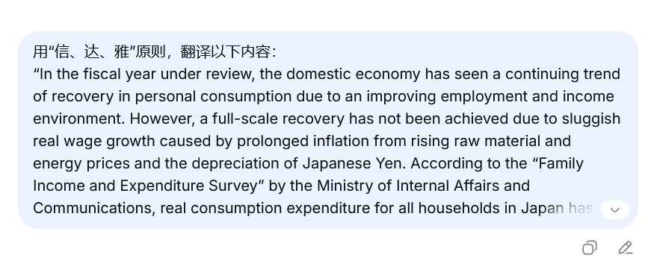

Slide 34
“用“信、达、雅”原则，翻译以下内容：…”
---- by Jamie Huang (2026.9.13)

Slide 35
原文：In the fiscal year under review, the domestic economy has seen a continuing trend of recovery in personal consumption due to an improving employment and income environment. However, a full-scale recovery has not been achieved due to sluggish real wage growth caused by prolonged inflation from rising raw material and energy prices and the depreciation of Japanese Yen. According to the “Family Income and Expenditure Survey” by the Ministry of Internal Affairs and Communications, real consumption expenditure for all households in Japan has been negative for three consecutive years, and it is expected that consumers’ saving orientation due to a defensive attitude towards their livelihoods will continue. On the other hand, there are some signs of brightness, with some items turning positive outside of food and housing, which have been strongly affected by inflation. However, in the global economy, in addition to the prolonged situation in Ukraine, the uncertainty in the Middle East situation increases concerns that it could bring great uncertainty to the domestic economy in the future. In addition, Japan is in a position to be affected by the global economy through policy trends, as represented by the trade policy of the United States, and the business environment remains difficult to foresee. Under these circumstances, in our core pachinko business, we have continued to promote the efficient installation of gaming machines, as we did last year, and are in the process of updating our record for the largest number of installed gaming machines since our founding. As a result, gross pay-ins (pachinko and pachislot hall revenue) increased by 2.7% year-on-year to ¥149,054 million.

Slide 36
译文1：本报告期财年，随着就业和收入环境改善，国内个人消费持续呈现复苏势头。然而，原材料和能源价格上涨以及日元贬值导致通胀长期化，实际工资增长乏力，因此尚未实现全面复苏。总务省《家庭收支调查》显示，日本全体家庭的实际消费支出已连续三年负增长，预计消费者出于对生活的防御心态而形成的储蓄倾向仍将持续。另一方面，也出现一些亮色：除受通胀影响严重的食品和住房外，部分项目已转为正增长。但在全球经济层面，除乌克兰局势久拖不决外，中东局势的不确定性也加剧了人们的担忧，即未来国内经济可能面临巨大不确定性。此外，以美国贸易政策为代表的政策动向，使日本处于易受全球经济影响的位置，经营环境依然难以预料。在此形势下，我们在核心的弹珠机业务中，延续去年的做法，继续推进游戏机的高效设置，并正在刷新公司创立以来游戏机设置台数的最高纪录。结果，总投入金额（弹珠机及弹珠老虎机馆收入）同比增长2.7%，达到1,490.54亿日元。

Slide 37
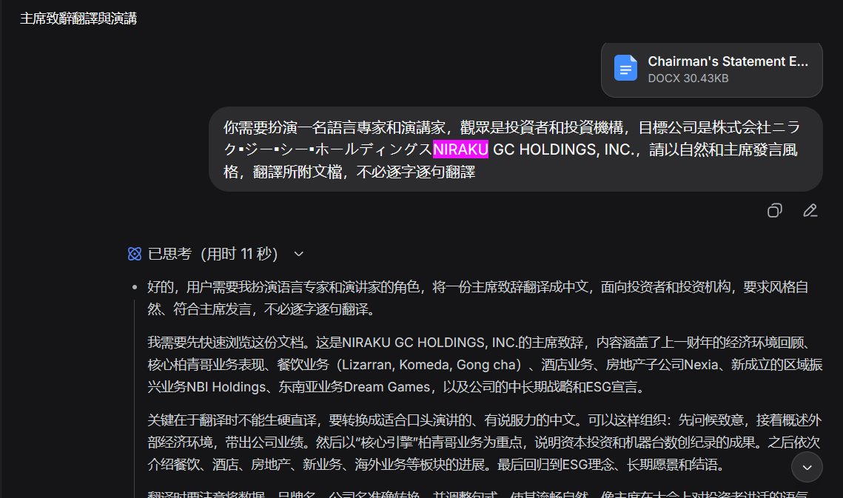

Slide 38
“你需要扮演一名語言專家和演講家，觀眾是投資者和投資機構，目標公司是株式会社ニラク▪ジー▪シー▪ホールディングスNIRAKU GC HOLDINGS, INC.，請以自然和主席發言風格，翻譯所附文檔，不必逐字逐句翻譯”
---- by Jamie Huang (2026.5)

Slide 39
译文1：本报告期财年，随着就业和收入环境改善，国内个人消费持续呈现复苏势头。然而，原材料和能源价格上涨以及日元贬值导致通胀长期化，实际工资增长乏力，因此尚未实现全面复苏。总务省《家庭收支调查》显示，日本全体家庭的实际消费支出已连续三年负增长，预计消费者出于对生活的防御心态而形成的储蓄倾向仍将持续。另一方面，也出现一些亮色：除受通胀影响严重的食品和住房外，部分项目已转为正增长。但在全球经济层面，除乌克兰局势久拖不决外，中东局势的不确定性也加剧了人们的担忧，即未来国内经济可能面临巨大不确定性。此外，以美国贸易政策为代表的政策动向，使日本处于易受全球经济影响的位置，经营环境依然难以预料。在此形势下，我们在核心的弹珠机业务中，延续去年的做法，继续推进游戏机的高效设置，并正在刷新公司创立以来游戏机设置台数的最高纪录。结果，总投入金额（弹珠机及弹珠老虎机馆收入）同比增长2.7%，达到1,490.54亿日元。
译文2：回顾过去这个财政年度，日本国内经济在就业与收入环境改善的支撑下，个人消费延续了复苏的趋势。然而，由于原材料和能源价格居高不下，加上日圆贬值，实质薪资增长乏力，消费的全面复苏尚未实现。总务省《家计调查》显示，全日本家庭实质消费支出已连续三年呈现负增长，预期消费者对生活开支的防卫心态与储蓄倾向仍将持续。另一方面，我们也看到一些曙光 — 除了受通货膨胀影响较深的食品与住房支出外，部分消费项目已转趋正面。然而，就全球经济而言，除了乌克兰局势的长期化之外，中东情势的不确定性也正日益加深「这可能为国内经济前景带来巨大不确定性」的忧虑。加上以美国贸易政策为代表的各国政策走向，日本无可避免地会受到全球经济的牵动，我们的经营环境依然难以预测。在这样的大环境下，我们的核心业务 — 日式弹珠机业务，如同去年般持续推动游戏机的高效配置，目前正处于创立以来最大游戏机安装数目的更新进程中。这使得我们的总投入额（日式弹珠机及日式角子机游戏馆收益）同比增长2.7%，达到149,054百万日圆。
V.S

Slide 40
译文2：回顾过去这个财政年度，日本国内经济在就业与收入环境改善的支撑下，个人消费延续了复苏的趋势。然而，由于原材料和能源价格居高不下，加上日元贬值，实质薪资增长乏力，消费的全面复苏尚未实现。总务省《家计调查》显示，全日本家庭实质消费支出已连续三年呈现负增长，预期消费者对生活开支的防卫心态与储蓄倾向仍将持续。另一方面，我们也看到一些曙光 — 除了受通货膨胀影响较深的食品与住房支出外，部分消费项目已转趋正面。然而，就全球经济而言，除了乌克兰局势的长期化之外，中东情势的不确定性也正日益加深「这可能为国内经济前景带来巨大不确定性」的忧虑。加上以美国贸易政策为代表的各国政策走向，日本无可避免地会受到全球经济的牵动，我们的经营环境依然难以预测。在这样的大环境下，我们的核心业务 — 日式弹珠机业务，如同去年般持续推动游戏机的高效配置，目前正处于创立以来最大游戏机安装数目的更新进程中。这使得我们的总投入额（日式弹珠机及日式角子机游戏馆收益）同比增长2.7%，达到149,054百万日圆。

Slide 41


Slide 42
“這是一篇領導致辭，“Aiming for Sustainable Growth with the Community...”，用致辭的風格翻譯”
---- by Jamie Huang (2026.5)

Slide 43
Thank You！

Slide 44
25年中文译文链接：https://www1.hkexnews.hk/listedco/listconews/sehk/2025/0605/2025060500874_c.pdf
26年中文译文链接:
https://www1.hkexnews.hk/listedco/listconews/sehk/2026/0604/2026060402926_c.pdf

Slide 45
（以下为附录）

Slide 46
KJV、ASV 和 TEV 是英语《圣经》翻译史上三个具有代表性的译本。它们分别对应不同的时代、底本和翻译哲学，尤其与奈达的“功能对等”理论形成鲜明对照。
缩写 | 全称 | 出版年 | 中文常用名
KJV | King James Version (Authorized Version) | 1611 | 钦定本 / 英王詹姆斯版
ASV | American Standard Version | 1901 | 美国标准版
RSV | Revised Standard Version | 新约部分于1946年出版，旧约于1952年出版，次经于1957年完成 | 修订标准版
TEV* | Today's English Version | 1966（新约）；1976（全书） | 现代英文译本 / 福音圣经
* TEV 后来常被称为 Good News Bible (GNB) 或 Good News Translation (GNT)。
…返回

Slide 47
该版《新约》的出版者为博纳文图拉·埃尔泽维尔（Bonaventure Elzevir） 及其侄子亚伯拉罕·埃尔泽维尔（Abraham Elzevir）。在前言中，他们写下了这样一句话：
"Textum ergo habes, nunc ab omnibus receptum, in quo nihil immutatum aut corruptum damus.“
意即：“你因而拥有了那被所有人所接受的文本，其中我们没有给出任何被改动或败坏的内容。”
正是从这句话中，"textum" 与 "receptum" 这两个词被后人提取出来，组合成了 "Textus Receptus" 这一固定术语，用以指称这一被普遍接受的希腊语《新约》文本形式。
…返回

Slide 48
批判文本(Critical Text)指通过文本批评（Textual Criticism） 方法，比较众多抄本后重建的、最接近原稿的圣经文本。它是现代许多圣经译本翻译时所依据的源文本底本
…返回

Slide 49
“他者性”（Otherness）并非由单一学者一次性提出的术语，而是在20世纪哲学史上逐步演化和确立的核心概念。它的思想根基可追溯至黑格尔，而列维纳斯则赋予了它最决定性的伦理内涵。以下梳理其关键的思想源头与标志性文献。
概念的源流与关键人物
哲学奠基：黑格尔（G.W.F. Hegel）
“他者”作为自我意识构成要素的观念，最早由黑格尔在哲学上提出。他在 《精神现象学》（Phänomenologie des Geistes, 1807） 的“主人与奴隶”章节中，论述了自我意识如何通过与他者的对峙与承认来形成。
伦理转向：列维纳斯（Emmanuel Levinas）
法国哲学家列维纳斯赋予了“他者性”最决定性的伦理强调，并推动了该术语的广泛传播。他认为西方哲学传统倾向于将他者还原为“同一者”，而真正的“他者性”（altérité）是绝对的、不可被同化的，它构成了伦理学的基础。其相关论述主要见于 《整体与无限》（Totalité et Infini, 1961） 及后来的文集 《他异性与超越》（Altérité et Transcendence, 1970/1999）。
劳伦斯·韦努蒂（Lawrence Venuti） 在 《译者的隐身》（The Translator’s Invisibility, 1995） 中，将“他者性”引入翻译批评，批判“流畅”的归化翻译掩盖了源语文本的文化差异，主张通过“异化”策略来保留外语文本的语言与文化差异，从而显现其“他者性”。
…返回

Slide 50
“归化”的学术源流
1. 理论先驱：施莱尔马赫（1813）
施莱尔马赫在1813年的演讲 《论翻译的不同方法》（Über die verschiedenen Methoden des Übersetzens） 中，首次提出了翻译的两条根本路径：要么尽可能让读者不动，将作者带到读者面前；要么尽可能让作者不动，将读者带到作者面前。这一二分法构成了后来“归化/异化”的理论原型。韦努蒂本人也明确承认其理论借鉴了施莱尔马赫的这一论述。
2. 术语确立：韦努蒂（1995）
韦努蒂在 《译者的隐身：一部翻译史》（The Translator‘s Invisibility: A History of Translation） 中，正式将 “domestication” 与 “foreignization” 确立为翻译研究的核心术语，用以描述两种对立的翻译策略。根据翻译研究领域的共识，韦努蒂是第一个在现代意义上系统表述并引入这两个术语的人。他在书中将“归化”定义为“对外语文本进行种族中心主义的缩减，使其符合目标语言的文化价值观，将作者带回家”（an ethnocentric reduction of the foreign text to target-language cultural values, bringing the author back home）。
3. 中文语境的特殊脉络
值得注意的是，“归化”作为中文术语，其使用早于韦努蒂。有学者考证，鲁迅于1935年已率先使用“归化”一词讨论翻译策略，并提出“保存洋气”的主张。韦努蒂1995年的著作被引介后，国内学者将“domestication”译为“归化”，此后这一译法才与韦努蒂的理论紧密绑定。因此，中文“归化”与英文“domestication”之间并非直接的借用关系，而是术语翻译后产生的汇流。
…返回

Slide 51
Nichols 论文中“明晰性”（explicitness）这一概念，并非泛指译文表达的清晰，而是一个具有特定批判指向的术语。它指的是在翻译过程中，将源语文本中含蓄、隐含或依赖文化语境才能理解的内容，在译文中刻意地、系统地加以明确化和解释。 Nichols 认为，这种对“明晰性”的追求，恰恰是功能对等模式在跨文化圣经翻译中产生负面后果的关键机制之一。
“明晰性”的具体含义
在奈达的功能对等理论中，“明晰性”被视为一种必要且正当的翻译手段。奈达认为，源语中“重要的语义元素可能隐含其中”，在接收语中“可能需要明确地标识出来”。例如，将“税吏”解释为“收税的人”，或将文化特定的比喻替换为更易懂的表达，都是“明晰化”的操作。
然而，Nichols 指出，当这种“明晰化”成为翻译的系统性驱动力（drive for explicitness）时，它就不再是中性的技术手段，而会演变为一种认知框架的强加。
…返回

Slide 52
参考文献
Nida, E. A. (1964). Toward a science of translating: With special reference to principles and procedures involved in Bible translating. E. J. Brill.
Elzevir, Bonaventure, and Abraham Elzevir, editors. Novum Testamentum. Ex Regiis Aliisque Optimis Editionibus, Hac Nova Expressum: Cui Quid Accesserit, Praefatio Docebit. Leiden: Ex Officina Elzeviriana, 1633.
Venuti, L. (1995). The translator's invisibility: A history of translation. Routledge.
Nichols, A.H. (1996). Translating the Bible: A critical analysis of E.A. Nida's theory of dynamic equivalence and its impact upon recent Bible translations. PhD thesis. University of Sheffield.
Felber, S. (2025). Toward a science of translating? Eugene A. Nida and his theory of dynamic equivalence (TRANSÜD, Vol. 150). Frank & Timme.
Felber, S. (2023) ‘Functional equivalence: Eugene Nida’s theory, its challenge for Bible translation, and its theological burden’, HIPHIL Novum, 8(1), pp. 28–47.
https://www1.hkexnews.hk/listedco/listconews/sehk/2025/0605/2025060500657.pdf
https://www1.hkexnews.hk/listedco/listconews/sehk/2025/0605/2025060500658_c.pdf
https://www1.hkexnews.hk/listedco/listconews/sehk/2026/0604/2026060402791.pdf
https://www1.hkexnews.hk/listedco/listconews/sehk/2026/0604/2026060402792_c.pdf

